Slide 1
Programmable
macropad
C304 Project
Studetns:
Harun Tucaković &
Muhammed Mušanović
Mentor:
Prof. Ali Abd Almisreb, PhD

Slide 2
Our goal
Agenda Style
Create a programmable macropad which is going to provide user with additional functionalities that are not available on standard keyboard.
Additional keys should be completely customizable and programmable using simple GUI.
NOTE: Due to coronavirus outbreak and quarantine that closed the whole world during the semester we were unable to get our hands on the hardware parts needed for creating actual physical macropad. Therefore, we created GUI simulation of the macropad. It is a software that acts like physical macropad would behave and provides a possibility to fully test the application and project as a whole.

Slide 3
Introduction
Agenda Style
The project consists out of two applications:
Macropad - simulation of the physical macropad.
Macropad Settings - main macropad driver with GUI for configuring the Macropad.
Applications are developed for Unix based operating systems.
They are designed to communicate over wireless or ethernet connection on LAN (Local Area Network).

Slide 4
Macropad
Agenda Style
Macropad simulation application consists out of simple GUI and server (for effective communication with Macropad Settings application).
After connecting to the server (by entering IP address of machine which is running Macropad Settings), one is able to use application by pressing button that one wants.

Slide 5

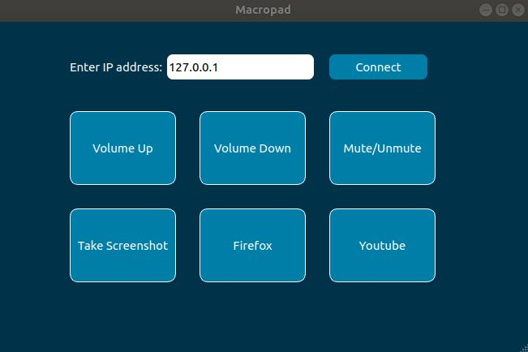
Macropad
application

Slide 6
Macropad Settings
Agenda Style
Macropad Settings application also consists out of GUI and server part. It acts like driver for Macropad and provides much more functionalities.
Provides one with simple GUI to customize names and functionalities of butons on the macropad.
There are six in-built command/functionalities from which user can choose, but there is also option to add custom command and name for button.

Slide 7

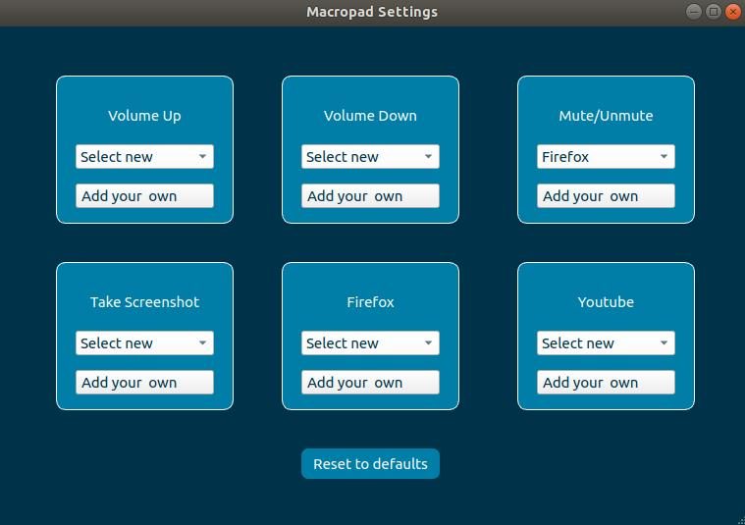
Macropad
Settings
application

Slide 8
Implementation
Agenda Style
Applications are completely developed in C++ programming language.
For developing both graphical user interfaces QT Creator is used, which is free and open-source C++ toolkit for developing GUI.
To be able to continuously run communication server and actual GUI application in parallel as a same program we used multithreading techniques and pthread library in C++.

Slide 9
Results
Agenda Style
This project has slightly changed compared to our project proposal that was provided at the beginning of the semester.
Changes that were made are due to worldwide coronavirus pandemic that prevented us from getting necessary hardware.
But, on the other hand, it provided us with opportunity to create this simulation that works in the same exact way in which physical macropad would work.

